Slide 1
A RELIABLE & ROBUST DDOS ATTACK DETECTION IN IOT USING NEURAL NETWORK
BATCH : C11
GUIDE : MRs .R. DEVI
TEAM MEMBERS :
VARSHA S (2017PECCS248)
VALARMATHI R(2017PECCS246)

Slide 2
ABSTRACT
Application Layer Distributed Denial of Service (DDoS) attacks are very challenging to detect and mitigate. The various possible application layer attacks are HTTP flooding, XML attack, DNS attacks, etc. These attacks work by drowning a system with requests for data . Various methods were used to defend these attacks based on distributed schemes with certain difficulties to count the packets or duplicates sent by a node. This is due to lack of communication infrastructure. The main contribution of this project are data analysis , Dataset preprocessing , training and testing the dataset. This method will provide better results compared to other techniques.

Slide 3
LITERATURE SURVEY
Title | SDN-Assisted Slow HTTP DDoS Attack Defense Method
Authors | Kiwon Hong, Younjun Kim, Hyungoo Choi, and Jinwoo Park
Published Year | 2017
Efficiency | Defeat application-level DDoS attacks Use cross-layer traffic analysis Bound to a variety of transport protocols
Drawbacks | Various DDoS has not been well addressed in this paper Computational cost in training the model is high Very calculation intensive while training the model
Description | A Slow HTTP Distributed Denial of Service (DDoS) attack causes a web server to be unavailable, but it is difficult to detect in a network because its traffic patterns are similar to those of legitimate clients. In this paper, we propose a network-based Slow HTTP DDoS attack defense method which is assisted by a Software-Defined Network (SDN) that can detect and mitigate Slow HTTP DDoS attacks in the network. Simulation results show that the proposed Slow HTTP DDoS attack defense method successfully protects web servers against Slow HTTP DDoS attacks.

Slide 4
LITERATURE SURVEY (CONTD)
Title | Software-Defined Networking (SDN) and Distributed Denial of Service (DDoS) Attacks in Cloud Computing Environments: A Survey, Some Research Issues, and Challenges
Authors | Qiao Yan, F. Richard Yu Qingxiang Gong, and Jianqiang Li
Published Year | 2015
Efficiency | It is cost effective, by allowing reuse of information extracted It makes no compromise of QoS
Drawbacks | Several important issues and research challenges which are open and yet to be addressed Lead to the generation of bad candidate proposals
Description | In this paper, we discuss the new trends and characteristics of DDoS attacks in cloud computing, and provide a comprehensive survey of defense mechanisms against DDoS attacks using SDN. This work can help to make full use of SDN’s advantages to defeat DDoS attacks in cloud computing environments and how to prevent SDN itself from becoming a victim of DDoS attacks, which are important for the smooth evolution of SDN-based cloud without the distraction of DDoS attacks.

Slide 5
LITERATURE SURVEY (CONTD)
Title | Botnet in DDoS Attacks: Trends and Challenges
Authors | Nazrul Hoque, Dhruba K Bhattacharyya and Jugal K Kalita
Published Year | 2015
Efficiency | Integrates multiple traceback mechanism with customization support Effectively block Slow HTTP DDoS attacks, allowing a web server to sustain its normal operation
Drawbacks | Does not provide a generic solution Leads to a biased outcome of predictions in terms of misclassification error and accuracy rates.
Description | Botnets pose a major threat to network security as they are widely used for many Internet crimes such as DDoS attacks, identity theft, email spamming and click fraud. Botnet based DDoS attacks.. This paper presents a comprehensive overview of DDoS attacks, their causes, types with a taxonomy and technical details of various attack launching tools. A detailed discussion of several botnet architectures, tools developed using botnet architectures and pros and cons analysis are also included. Furthermore, a list of important issues and research challenges is also reported in the paper.

Slide 6
LITERATURE SURVEY (CONTD)
Title | DDoS Tools: Classification, Analysis and Comparison
Authors | Bharti Nagpal, Pratima Sharma, Naresh Chauhan, Angel Panesar
Published Year | 2015
Efficiency | Detecting either low-rate or high-rate DDoS attacks Achieved competitive performance on various datasets
Drawbacks | Performance is also highly influenced by multiple user parameters. Lack of unbiased evaluation frameworks, including benchmark datasets
Description | In the last few years, it is recognised that DDoS attack tools and techniques are emerging as effective, refined, and complex to indicate the actual attackers. Due to the seriousness of the problem many detection and prevention methods have been recommended . This paper aims to provide a better understanding of the existing tools, methods and attack mechanism. In this paper, we commenced a detailed study of various DDoS tools. This paper can be useful for researchers and readers to provide the better understanding of DDoS tools in present times.

Slide 7
TECHNOLOGY STACK
HARDWARE REQUIREMENTS Hardware : Minimum Requirement Disk Space : 32 GB or more,10 GB or more for Foundation Edition
Processor : 1.4 GHz 64 bit Memory : 512 MB

Slide 8
SOFTWARE REQUIREMENTS
Backend Technologies ✓ Python -Anaconda ✓ Numpy ✓ Sci-learn ✓ Jupyter Notebook Frontend Technologies ✓ Web Technologies ✓ Bootstrap

Slide 9
EXISTING SYSTEM
✓ The existing system Misbehavior detection system (MDS) can be deployed to detect and prevent internal attacks.
✓ Existing system MDS is trained using datasets based on the realistic vehicular network environment. To improve the accuracy of the detection, we have employed the Dempster - Shafer (DS) theory -based collaborative misbehavior detection system.
✓ In the existing system scheme, the reputation score of each vehicle is used as a belief value for DS based feedback combination. An attacker can control some vehicles or groups of vehicles to broadcast false information. An attacker can broadcast false alerts. These kinds of false alerts can cause huge accidents, thus, it is very crucial to detect them.

Slide 10
DRAWBACK OF EXISTING SYSTEM
✓ It achieves low-latency in delivery with less energy consumption. ✓ The detection performance is not improved. ✓ Parties need to be involved. ✓ Cannot overcome inter-packet dependency.

Slide 11
PROPOSED SYSTEM
✓ The proposed system presents a scheme that is based on the periods and uses a blacklist to efficiently prevent the data flooding attack, by checking the data packet floods at the end of each period in order to enhance the throughput of burst traffic. Therefore, it can guarantee the Quality of Service (QoS) of burst traffic. ✓ In the proposed Single-copy routing after sending a packet out, a node deletes its own copy of the packet. Thus, each packet only has one copy in the network. ✓ In the proposed Multicopy routing to the source node of a packet sprays a certain number of replicas of the packet to other nodes and each copy is separately routed using the single-copy strategy. ✓ In the proposed, Propagation routing when a node locates it appropriate to send a packet to another encountered node, it replicates that packet to the encountered node & keeps its own fake.

Slide 12
ADVANTAGES OF PROPOSED SYSTEM
✓ Reduce false alarm probability ✓ Cost reduction for its users ✓ Higher accuracy ✓ Opaqueness since routers need not be involved.
✓ Successfully minimize the amount of traffic

Slide 13
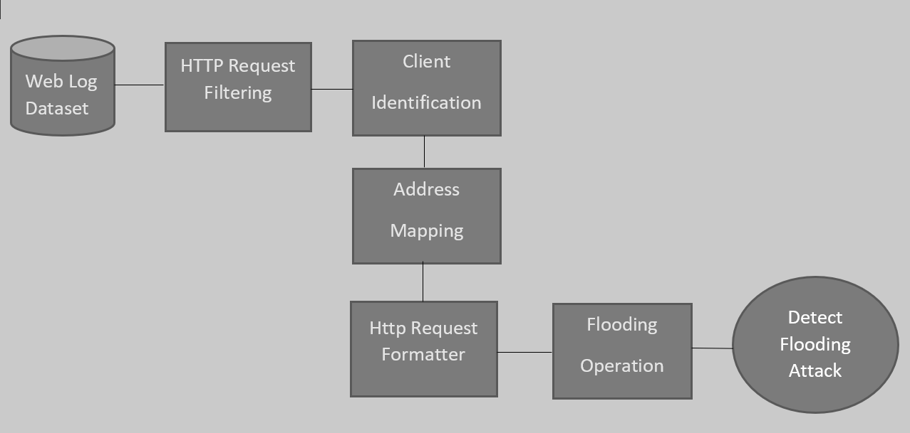
SYSTEM ARCHITECTURE

Slide 14
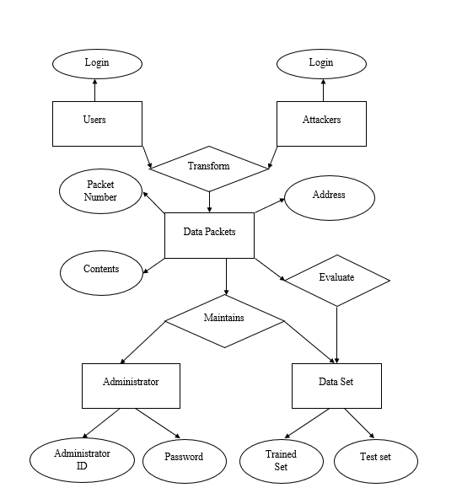
SYSTEM DESIGN (ER DIAGRAM)

Slide 15
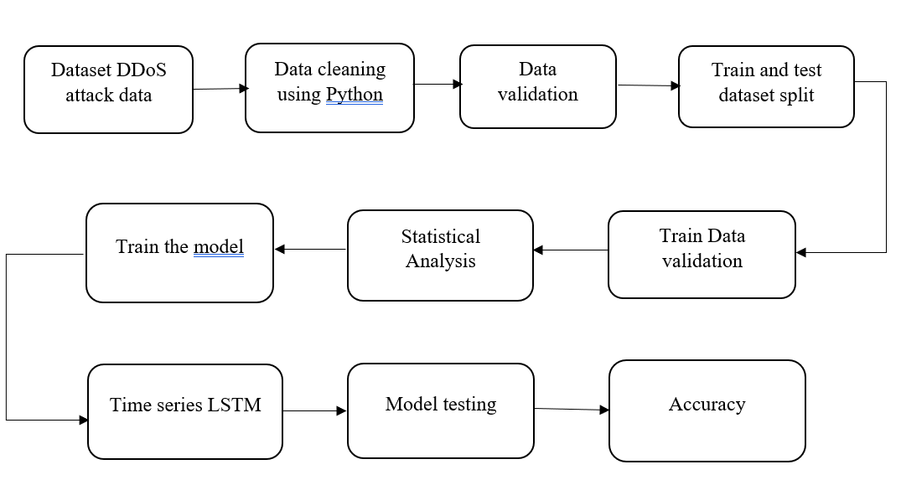
(DATA FLOW DIAGRAM)

Slide 16
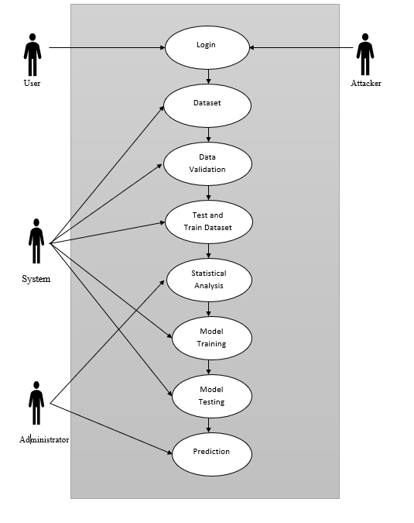
(USE CASE DIAGRAM)

Slide 17
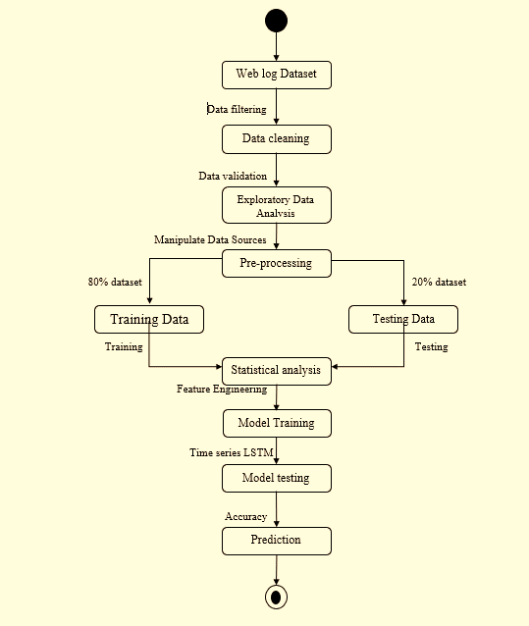
(ACTIVITY DIAGRAM)

Slide 18
MODULES
✓ Module 1 : Exploratory Data Analysis ✓ Module 2 : Pre-processing
✓ Module 3 : Feature Engineering ✓ Module 4 : Prediction

Slide 19
Module 1 : Exploratory Data Analysis
✓ Exploratory Data Analysis (EDA) is the first step in your data analysis process.
✓ Exploratory Data Analysis is valuable to data science projects since it allows to get closer to the certainty. Such level of certainty can be achieved only after raw data is validated and checked for anomalies, ensuring that the data set was collected without errors.
✓ EDA is performed in order to define and refine the selection of feature variables . Once data scientists become familiar with the data set, they often have to return to feature engineering step, since the initial features may turn out not to be serving their intended purpose. Once the EDA stage is complete, data scientists get a firm feature set they need for supervised and unsupervised machine learning.

Slide 20
MODULE 2 : PRE PROCESSING
✓ The library that we are going to use for the task is called Scikit Learn preprocessing. It contains a class called Imputer which will help us take care of the missing data.
✓ splitting the dataset into two sets — a Training set and a Test set. We will train our machine learning models on our training set and then we will test the models on our test set to check how accurately it can predict. A general rule of the thumb is to allocate 80% of the dataset to training set and the remaining 20% to test set. For this task, we will import test_train_split from model_selection library of scikit.

Slide 21
MODULE 3 : FEATURE ENGINEERING
✓ Filter methods are generally used as a preprocessing step.
✓ The selection of features is independent of any deep learning algorithms.
✓ Instead, features are selected on the basis of their scores in various statistical tests for their correlation with the outcome variable. The correlation is a subjective term here.
✓ For basic guidance, referring the correlation co-efficients Pearson’s Correlation , LDA , ANOVA & Chi-Square

Slide 22
MODULE 4 : PREDICTION
✓ Evaluation allows us to test our model against data that has never been used for training. This metric allows us to see how the model might perform against data that it has not yet seen. This is meant to be representative of how the model might perform in the real world. ✓ BRNN (Bidirectional Recurrent Neural Network) Model is the best suited model for prediction. It connects two hidden layers as the same output from that past and future information are gathered ✓ Once evaluation is done then training the model with few parameters and testing those assumptions and try other values

Slide 23
PERFORMANCE ANALYSIS
✓ The technique of comparing the performance of a specific situation in contrast to the aim and yet executed. The first step of analyzing raw data is validated and checked for anomalies , ensuring that the data set was collected without errors and then pre-processing step splits the dataset into trained set and test set , after training the model ,it’s completely ready for evaluation . Once evaluation done . ✓ It’s possible to improve the training any way and the prediction of attackers and non-attackers counts will be well aimed than the existing model.

Slide 24
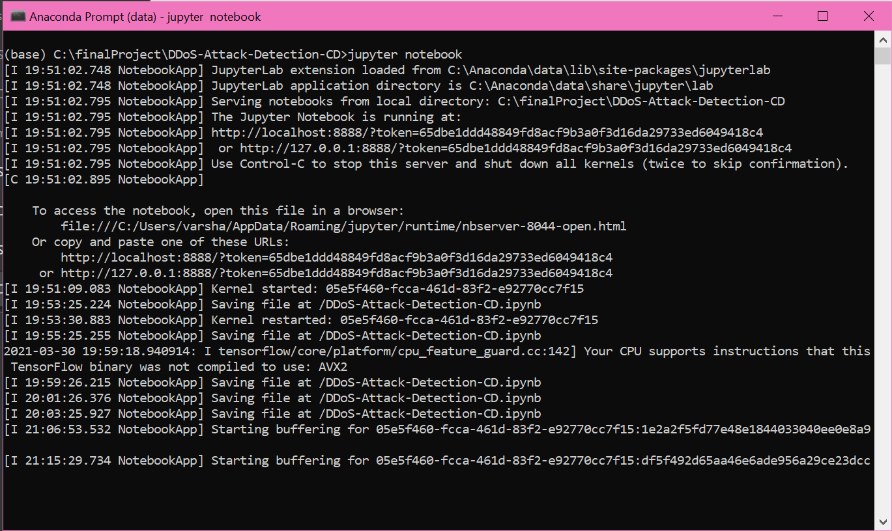
SAMPLE SCREENSHOTS (ANACONDA PROMPT)

Slide 25
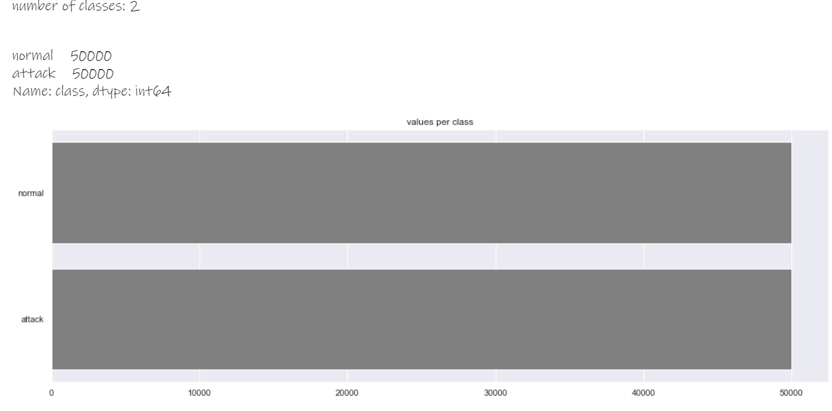
(VALUE PER CLASS)

Slide 26
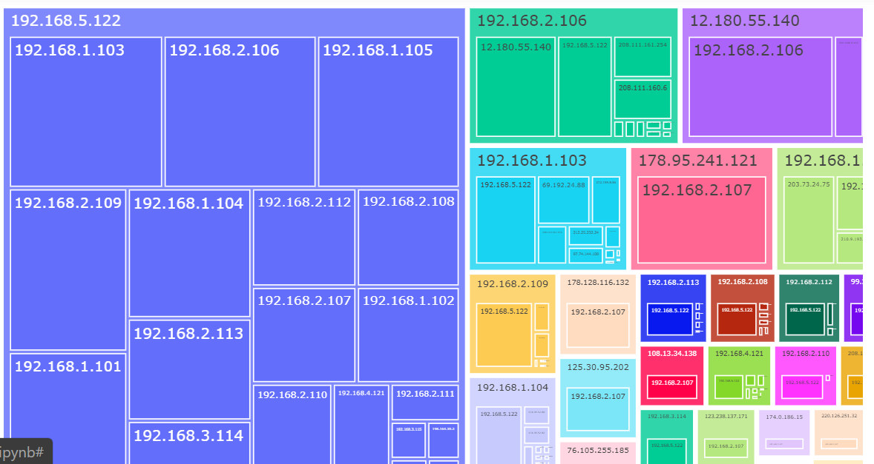
(TREEMAP)

Slide 27
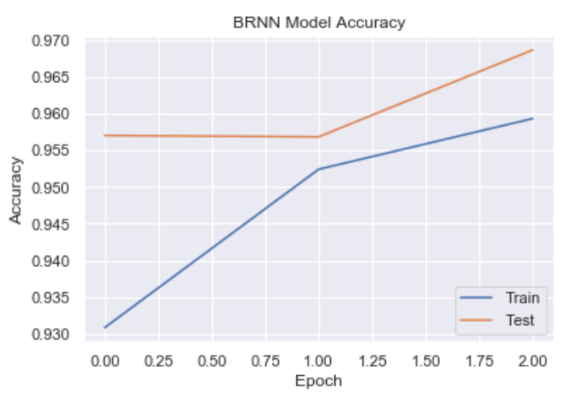
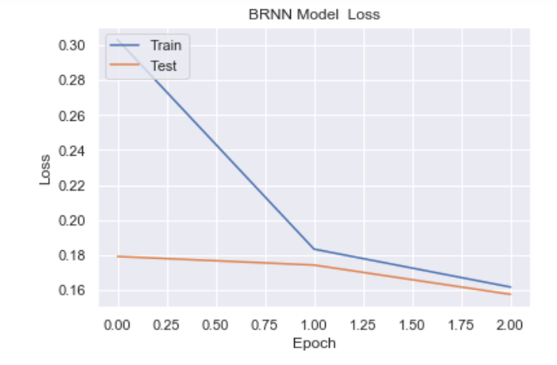
(BRNN MODEL ACCURACY)
( BRNN MODEL LOSS)

Slide 28
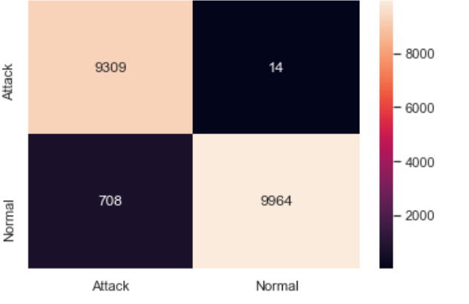
(OUTPUT)
Screenshots(output)

Slide 29
CONCLUSION
Reducing the attacks by employing rate limitations and Probabilistically to detect number of packets which are violating the rate limits. This works are implemented in distributed manner . They easily reduce the throughput of burst traffic by comparing with simple threshold. This scheme is better than the old scheme.
FUTURE ENHANCEMENT
In future , the model can be implemented can other attacks like application layer attack ,protocol attack, volumetric attack with large dataset using ANN.

Slide 30
REFERENCES
[1]Compagno, & al., “Poseidon: Mitigating interest flooding ddos attacks in named data networking,” in Local Computer Networks (LCN), Intl’ Conf. on. IEEE, 2013, pp. 630– 638. [2]Afanasyev, & al., “Interest flooding attack and countermeasures in named data networking,” in IFIP Networking Conference. IEEE, 2013, pp. 1–9. [3]Ghali, & al., “Closing the floodgate with stateless content-centric networking,” in 2017 26th International Conference on Computer Communication and Networks (ICCCN), July 2017, pp. 1–10. [4]T. Zhi, H. Luo, and Y. Liu, “A gini impurity-based interest flooding attack defence mechanism in ndn,” IEEE Communications Letters, vol. 22, no. 3, pp. 538–541, March 2018.

Slide 31
REFERENCES (CONTD)
[5]Y. Xin, & al., “Detection of collusive interest flooding attacks in named data networking using wavelet analysis,” in IEEE Military Communications Conference (MILCOM), Oct 2017, pp. 557–562. [6]K. Wang, & al., “On the urgency of implementing Interest NACK into CCN: from the perspective of countering advanced interest flooding attacks” in IET Networks, vol. 7, no. 3, pp. 136–140, 2018. [7]S. DiBenedetto and C. Papadopoulos, “Mitigating poisoned content with forwarding strategy,” in 2016 IEEE Conference on Computer Communications Workshops (INFOCOM WKSHPS), April 2016, pp. 164–16
[8]Yi, & al., “A case for stateful forwarding plane,” Computer Communications, vol. 36, no. 7, pp. 779–791, 2013.

Slide 32
REFERENCES (CONTD)
[9]Amandeep Verma Manpreet Singh Gujral “A Comprehensive Appraisal of Ad hoc Networks” International Journal of Computer Applications (0975– 8887) Volume 49– No.22, July 2012. [10]Shahanaz Begum I, Geetharamani G, “DDoS Attack detection and Prevention in Private Cloud Environment “,International Journal of Innovations in Engineering and Technology (IJIET), Vol.7 Issue.3, Oct 2016, pp. 527- 531 [11]S. Umarani, D. Sharmila, ‘‘Predicting Application Layer DDoS Attacks Using Machine Learning Algorithms”, International Journal of Computer, Electrical, Automation, Control and Information Engineering Vol.8, No.10, 2014, pp. 1912-1917

Slide 33
Thank You

